Slide 1
Introduction to Locations
November 21, 2014
Notes:
Guidewire training materials contain Guidewire proprietary information that is subject to confidentiality and non-disclosure agreements. You agree to use the information in this manual solely for the purpose of training to implement Guidewire software solutions. You also agree not to disclose the information in this manual to third parties or copy this manual without prior written consent from Guidewire. Guidewire training may be given only by Guidewire employees or certified Guidewire partners under the appropriate agreement with Guidewire.

Slide 2
Lesson objectives
By the end of this lesson, you should be able to:
Describe the way that locations are used to control navigation in the user interface
List the different types of locations
Modify widgets so that they navigate to given locations
This lesson uses the notes section for additional explanation and information. To view the notes in PowerPoint, choose View→Normal or View→Notes Page. If you choose to print the notes for the lesson, be sure to select “Print hidden slides.”

Slide 3
Lesson outline
Location fundamentals
Enable navigation to a location

Slide 4
Locations
PCF Element
PCF element one can navigate to
Widget
Location
Atomic Widget
Container Widget
Location Group
Page
A location is a PCF element that a user can navigate to
Define how user navigates from one UI to the next UI
Wizard
Popup
Worksheet
Forward
Exit Point
Notes:
Both Widget and Location are conceptual representations in this diagram. There are no <Widget /> or <Location /> elements.
At the top-level, PCF elements are split between widgets and locations. A widget is a PCF element that is transformed into HTML and becomes a (potentially) visible element of the user interface. There are two broad categories of widgets:
Atomic widgets are the individual elements of the user interface that either display data (such as fields and cells in a list) or let users execute actions (such as buttons and menu items).
Container widgets group atomic widgets or other container widgets into logical groups.
A location is a PCF element that a user can navigate to. Locations determine how users move from one place in the application to some other place in the application.

Slide 5
Types of locations
Primary difference between different types of locations:
How many screens can it reference?
Where are screens rendered?
Is previous location remembered?
Location
Location Group
Page
Wizard
Popup
Worksheet
Forward
Exit Point

Slide 6
Container widgets and locations
Page
Screen
A location references a specific screen
Screens form the bridge between what the application displays and how users work and navigate in the application
Wizard
Popup
Worksheet
Card View Panel / List Detail Panel
Detail View Panel
List View Panel
Input Sets
Atomic Widgets

Slide 7




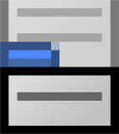



Screens connect locations to panels
Screen
page
Detail View Panel
popup
List View Panel
Card View Panel
wizard
worksheet
List Detail Panel
Screens connect locations and views
Almost every location contains a screen
Every view is contained within a screen
When you navigate to given location, its screen (or one of its screens) is displayed
Notes:
Some locations do not contain a screen: a Forward references Pages and an Exit Point references external web locations.
LocationGroups indirectly reference screens by meansof the LocationRef, which points to a Page.
If a location references multiple screens, then the first screen referenced by the location is displayed by default.

Slide 8

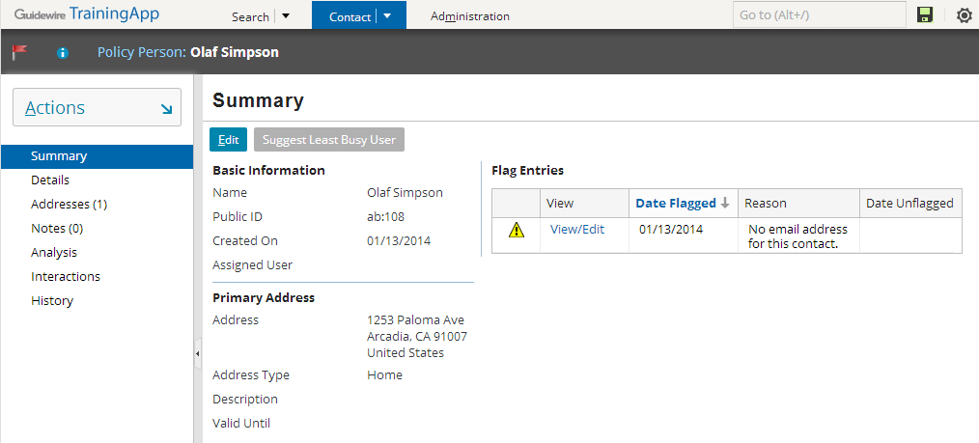
Pages
A page contains a single screen
Page
Screen
Notes:
Pages are the most common location. Most of the pages in the Guidewire base applications are child locations to a location group, though it is not a requirement that they be.

Slide 9

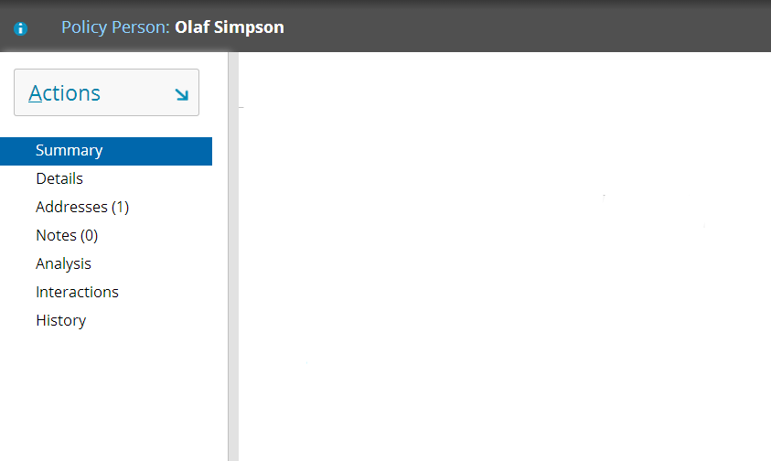
Location groups
A location group is a collection of pages used to view or modify data
Each group has single info bar, actions menu, and side bar
menu
Info bar
Summary page
Details page
Addresses page
Notes page
Analysis page
Interactions page
Side bar
History page
Notes:
A location group can be thought of as a "page group" as it is fundamentally a collection of pages, each with its own screen. Location groups are used to gather together a set of screens that display data about a single primary object (such as a contact, a policy, an account, or a claim) or serve a single major application function (such as searching for data). Users navigate from one page in a location group to the next by clicking the links in the side bar.
All the pages in a location group share a common info bar, actions menu, and side bar.
The info bar is the gray strip directly below the screen tabs which usually contains widgets providing high-level information about the data in the screen area. In the example above, the info bar contains a "person" icon and the label "Person: Karen Espinoza". Some location groups do not have info bars, in which case the gray strip is blank.
The actions menu is the menu accessible by clicking the "Actions" control.
The side bar appears on the left of the screen and contains a set of links to the pages in the location group.
Pages and location groups are both locations. This gives widgets the ability to navigate to the location group (in which case the screen for the first page listed in the location group is displayed) or to any page within the location group. For example, you might have one widget that needs to navigate to the ABContactLG location group, and a second widget that should specifically navigate to the Addresses page in the ABContactLG location group.

Slide 10

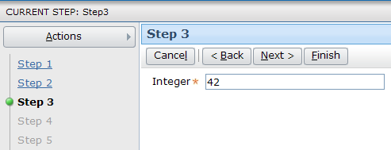
Wizards
A wizard is an ordered collection of screens used to execute a complex business process
Single info bar, actions menu, and side bar
Includes toolbar with Back and Next buttons
Info bar
menu
1
2
3
4
5
Side bar
Notes:
A wizard has multiple screens, but only one screen is displayed at a time. The screens in a wizard have an order (though it may be possible for a user to traverse the screens out of order).
The wizard shown above is from ExampleCenter, which is a non-business Guidewire application used to test and build examples of Guidewire platform functionality. Wizards are implemented differently in each business-oriented Guidewire application. Multiple examples of wizards appear on the following slides, one for each of the primary applications.

Slide 11
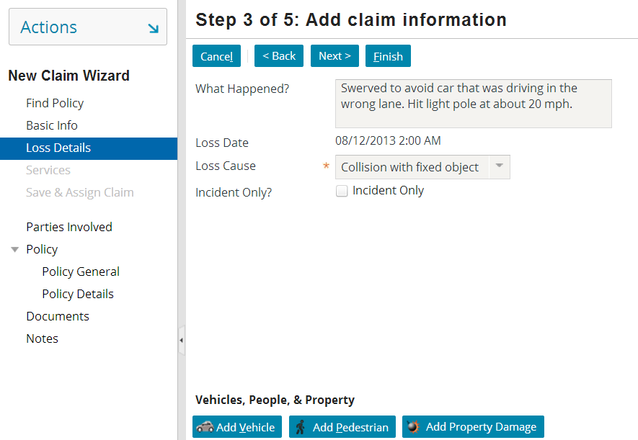
Wizard example: ClaimCenter
ClaimCenter wizards are used primarily to create new claims and issue payments
Notes:
The wizard shown above is the New Claim Wizard (also known as the First Notice of Loss (FNOL) Wizard). It is used to create claims.

Slide 12
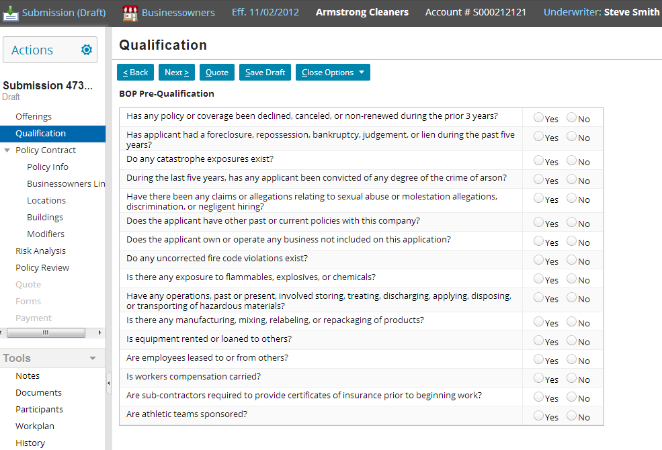
Wizard example: PolicyCenter
PolicyCenter wizards are used to create, modify, renew, or cancel policies
Notes:
The wizard shown above is the Submission Wizard, which is used to create and modify submissions. A submission ends when it is withdrawn or bound. A bound submission is a policy.

Slide 13
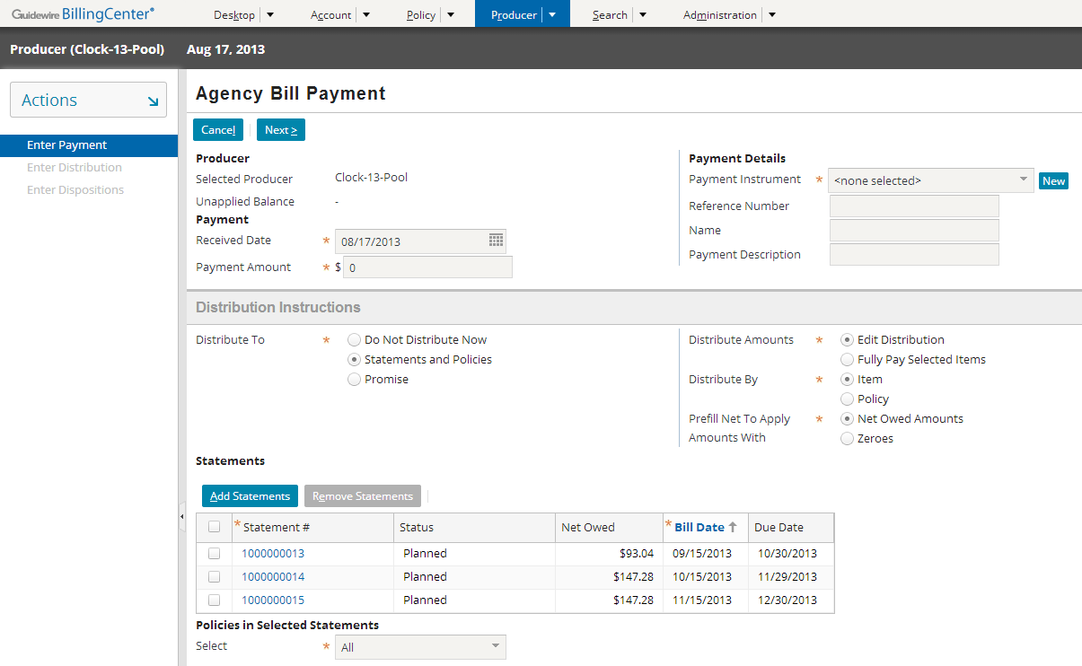
Wizard example: BillingCenter
BillingCenter wizards are used to enter payments as well as to create or modify producers and accounts as needed
Notes:
The wizard shown above is the Multiple Payment Wizard, which is used to credit multiple accounts and their policies with multiple payments in a single business process.

Slide 14
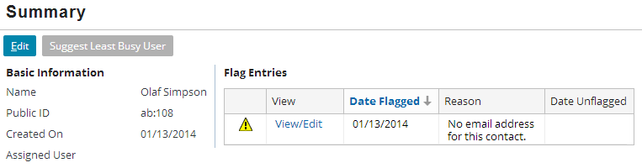
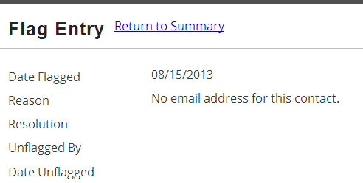
Popups
A popup contains a single screen and returns the user to the previous location once the popup is closed
Automatically has "Return to <previous location>" link
Notes:
Popup screens are designed to mimic the functionality of a true popup (which is an entirely separate window). True popups are difficult to architect because there is no easy way to avoid synchronization errors in which the system tries to update the same object in two separate windows. Popup locations as architected in Guidewire offer virtually the same functionality while avoiding the synchronization and usability issues.

Slide 15

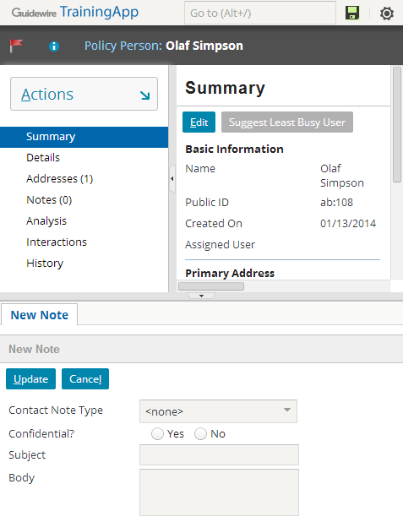
Worksheets
A worksheet contains a single screen rendered in the workspace frame
Worksheet
Notes:
The workspace is an area of the user interface that runs across the bottom. It is visible only when a screen is displayed within it. It is the one area of the user interface that is not always visible.
If multiple worksheets are rendered at one time, the tabs across the top of the worksheets can be used to navigate between worksheets.

Slide 16


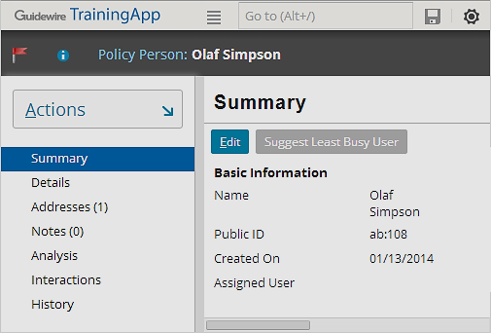
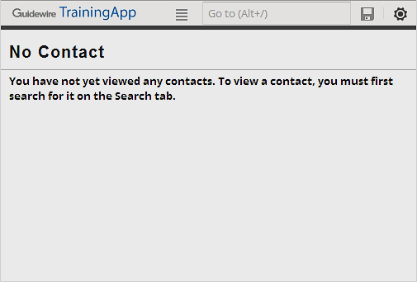
Forwards
A forward contains logic to execute before navigating to another location
Often involves deciding which location to navigate to
ContactTabForward
Viewed Contacts?
Yes
No
ABContactSummaryPage
NoContactPage
Notes:
You can use forwards to:
Modify data before navigating
Determine the destination location based on the data context or the user’s permissions

Slide 17
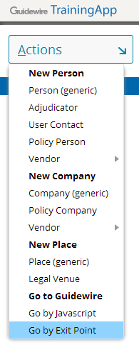
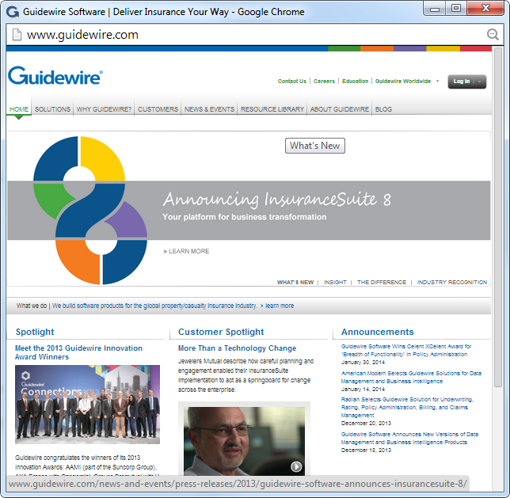
Exit points
An exit point points to a URL outside of the Guidewire application
Often used to access other applications or websites
Does not contain (directly or indirectly) a screen widget
Notes:
Exit points are typically used to let users easily access other applications, such as a reporting application.
The example above shows the display of Example List, which is a list of examples in TrainingApp of each fundamental configuration technology. Example list is technically outside of any Guidewire application because it is displayed in its own window. It is the only working example of an exit point in any of the base applications.

Slide 18



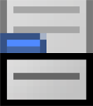
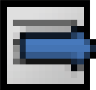
Review of locations navigation
Page
Location Group
Wizard
1
Page
2
Page
3
Page
Popup
Worksheet
Exit Point
Forward
Notes:
A page contains a single screen in the screen area.
A popup contains a single screen and is designed to return the user to the previous location once the work on the popup screen is complete.
A worksheet contains a single screen and a tab (on the bottom) in the workspace frame.
A location group groups a set of menu links (and their associated locations), a set of menu actions, and an info bar.
A wizard contains multiple screens in a specific order and a toolbar to work through the wizard.
A forward contains logic to execute before navigating to another location.
An exit point points to a URL outside of the PolicyCenter application.

Slide 19
Lessons on location configuration
Popups are discussed in this course
Pages, location groups, and wizards are discussed in the Application Config course for each product
Worksheets, exit points, and forwards are not covered
Popup
Page
Location Group
Wizard
1
Page
2
Page
3
Page
Worksheet
Exit Point
Forward
Notes:
The bulk of location configuration work tends to center around popups, pages, location groups, and wizards. Therefore, these are the only locations covered in the instructor-led portions of Guidewire training. (Popups are covered in this course because they behave the same in every application. Pages, location groups, and wizards are covered in the Application Configuration courses because each of these have product-specific behaviors.)

Slide 20
Lesson outline
Location fundamentals
Enable navigation to a location

Slide 21
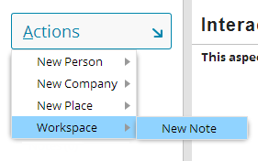
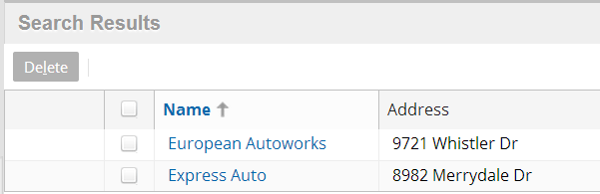
Atomic widget action property
clickable menu item
clickable cell
Most atomic widgets have an action property
Can be set to a Gosu statement
When set, atomic widget becomes clickable
When clicked, Gosu statement is executed
Notes:
Almost every widget that executes a navigation when clicked does so through the widget's "action" property. The only exception to this are the screen links in a location group's sidebar, which use a LocationRef property instead.
A menu item is an atomic widget typically found in menus (or menu items sets). It consists of a label that one can click to execute an action.

Slide 22
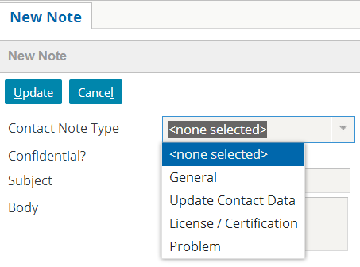
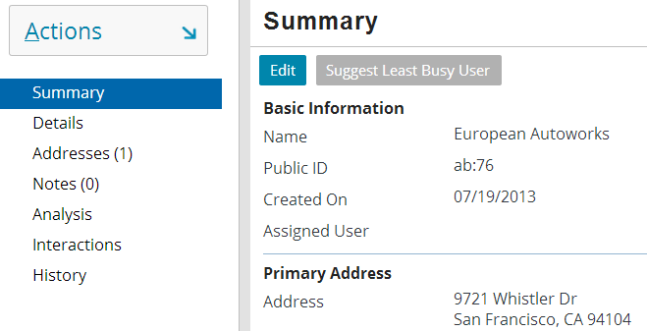
Atomic widgets that navigate
clickable menu item navigates to ContactNote worksheet
clickable cell navigates to ABContactSummary page
One common example of atomic widget action is navigation to a location

Slide 23

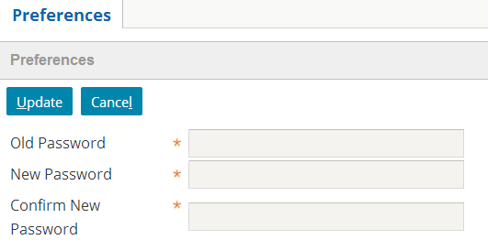
Location entry points
An entry point is a reference used by widgets to navigate to a given location
Specifies location name and values required to render location
Every location has at least one entry, but could have many
ABContactLG(anABContact)
UserPreferencesWorksheet()
Notes:
The slide shows two locations with their entry points:
ABContactLG, which is a location group. Its name is "ABContactLG", and it requires one object to be rendered: an ABContact. The location group renders information about the given ABContact.
UserPreferencesWorksheet, which is a worksheet. Its name is "UserPreferencesWorksheet", and it requires no values to be rendered—it uses the current user to determine what values to display.
A location uses multiple entry points when it is navigated to under different circumstances with different sets of values. An example of this can be seen in the "Popups" lesson.

Slide 24
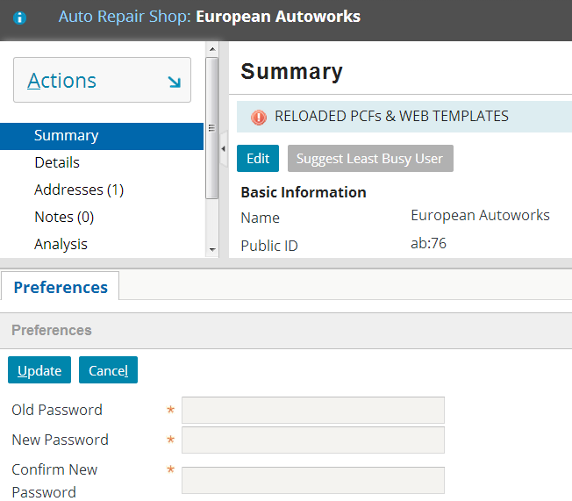
Location methods
Locations have methods used to navigate to them
go()
Renders location in same frame as source widget
goInWorkspace()
Renders location in workspace frame
push()
Renders location in same frame as source widget and retains previous location so that it can be returned to
screen area (main frame)
workspace frame
Notes:
The following navigation methods are sometimes available, but they are used less frequently:
goInMain() – go to the "main" frame (the screen area), no matter where the source widget is.
drilldown() – similar to "go", but it goes from a list view to a detail page while remembering the list context, so that you can navigate to the previous and next records in the detail page without having to return to the list view.

Slide 25
Enabling navigation for given widget
Open destination location's PCF file
Determine relevant entry point
Specify widget's action property
Deploy PCFs

Slide 26
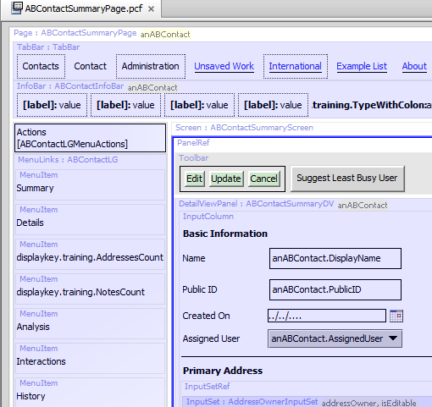
Step 1: Open destination location's PCF file
ALT+SHIFT+E opens PCF file in Studio
ALT+SHIFT+I (location info) details complete structure of visible screen, including its location
ALT+SHIFT+E

Slide 27
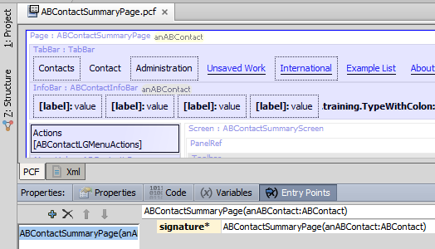
Step 2: Determine relevant entry point
Click name of location at top of PCF editor to display tabs
Entry points listed on Entry Points tab
name
object list

Slide 28
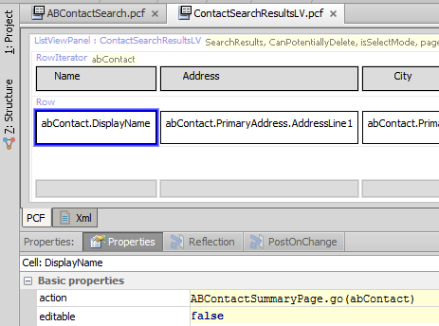
Step 3: Specify widget's action property
Syntax: locationName.method(objectList)
method is typically goInWorkspace (worksheets), push (popups, exit points, wizards) or go (location groups, pages, wizards, forwards)

Slide 29
Example of navigation configuration

Slide 30
Comparison of locations
 | Typical Navigation Method | Initially Displays | In
Forward | go() | nothing | -
Location Group | go() | First child page | Screen area
Page | go() | Screen | Screen area
Wizard | go(), push() | First screen | Screen area
Worksheet | goInWorkspace() | Screen | Workspace frame
Popup | push() | Screen | Originating frame
Exit Point | push() | External page or site | New window (or entire existing window)
Notes:
In ClaimCenter and PolicyCenter, navigation to a wizard typically uses go(). In BillingCenter, navigation to a wizard typically uses push().

Slide 31
Step 4: Deploy PCFs
Restart Server
Reload PCFs
PCFs read at server startup
ALT+SHIFT+L
Internal debug tools enabled
Internal Tools
Reload → Reload PCF Files
Page Configuration File
Page Configuration File
Notes:
It is also possible to reload PCF files using the Guidewire API and/or internal server tools. The Reload PCF command can be found on the Reload page in Internal Tools. To access Internal Tools, you must log in as an administrator user, e.g., su/gw. Then, use ALT+SHIFT+T. In the tab bar, select Internal Tools → Reload. On the Reload page, click the Reload PCF Files button. The Reload PCF Files button calls the static method gw.api.tools.InternalToolsUtil.reloadPCFs().

Slide 32
Lesson objectives review
You should now be able to:
Describe the way that locations are used to control navigation in the user interface
List the different types of locations
Modify widgets so that they navigate to given locations

Slide 33
Review questions
Of the seven types of locations listed...
Which two contain multiple screens and have their own info bar, actions menu, and side bar?
Which one renders a screen somewhere other than the screen area?
Which one typically navigates to one of several locations based on business logic?
Which location does not navigate (directly or indirectly) to a screen?
For each location, what method would you usually use to navigate to it?
Locations
Page
Location Group
Wizard
Popup
Worksheet
Forward
Exit Point
Notes:
Answers
1) Location group and wizard
2) Worksheet
3) Forward
4) Exit point
5) Use go to navigate to pages, location groups, wizards, and forwards.
Use push to navigate to popups and exit points.
Use goInWorkspace to navigate to worksheets.

Slide 34
Notices
Copyright © 2001-2014 Guidewire Software, Inc. All rights reserved.
Guidewire, Guidewire Software, Guidewire ClaimCenter, Guidewire PolicyCenter, Guidewire BillingCenter, Guidewire Reinsurance Management, Guidewire ContactManager, Guidewire Vendor Data Management, Guidewire Client Data Management, Guidewire Rating Management, Guidewire InsuranceSuite, Guidewire ContactCenter, Guidewire Studio, Guidewire Product Designer, Guidewire Live, Guidewire DataHub, Guidewire InfoCenter, Guidewire Standard Reporting, Guidewire ExampleCenter, Guidewire Account Manager Portal, Guidewire Claim Portal, Guidewire Policyholder Portal, ClaimCenter, BillingCenter, PolicyCenter, InsuranceSuite, Gosu, Deliver Insurance Your Way, and the Guidewire logo are trademarks, service marks, or registered trademarks of Guidewire Software, Inc. in the United States and/or other countries.
All other trademarks are the property of their respective owners.
This material is confidential and proprietary to Guidewire and subject to the confidentiality terms in the applicable license agreement and/or separate nondisclosure agreement.
This file and the contents herein are the property of Guidewire Software, Inc. Use of this course material is restricted to students officially registered in this specific Guidewire-instructed course, or for other use expressly authorized by Guidewire. Replication or distribution of this course material in electronic, paper, or other format is prohibited without express permission from Guidewire.
Guidewire products are protected by one or more United States patents.

